Slide 1
Ensemble Learning
Ensemble methods combine several trees base algorithms to construct better predictive performance than a single tree base algorithm. The main principle behind the ensemble model is that a group of weak learners come together to form a strong learner, thus increasing the accuracy of the model. When we try to predict the target variable using any machine learning technique, the main causes of difference in actual and predicted values are noise, variance, and bias. Ensemble helps to reduce these factors (except noise, which is irreducible error)

Slide 2
Ensemble basic means combining various model and train a particular dataset and finally data will get into the output.
Combining multiple model
Ensemble method basically have two techniques
Bagging Boosting
1)Random forest 1)ADAboost
2)Gradient Boosting
3)XgBoost

Slide 3
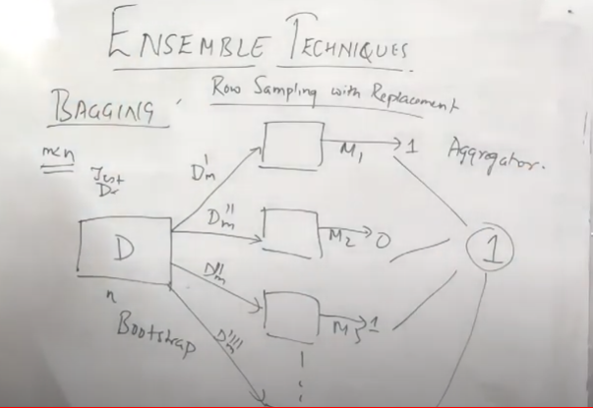
Bagging is also called as Bootstrap aggregator.
Example : Voting Classifier
Random forest will use multiple Decision Tree.

Slide 4
Random Forest Classifier&Regressor
Random forest classifier creates a set of decision trees from randomly selected subset of training set. It then aggregates the votes from different decision trees to decide the final class of the test object. In Laymen’s term,
Suppose training set is given as : [X1, X2, X3, X4] with corresponding labels as [L1, L2, L3, L4], random forest may create three decision trees taking input of subset for example,
[X1, X2, X3]
[X1, X2, X4]
[X2, X3, X4]
So finally, it predicts based on the majority of votes from each of the decision trees made.

Slide 5
